Slide 1
Query Processing and Optimization
Week - 2 ,Topic – 2, Lesson - 3
Query Processing

Slide 2
Outline
Query processing steps and core algorithms

Slide 3
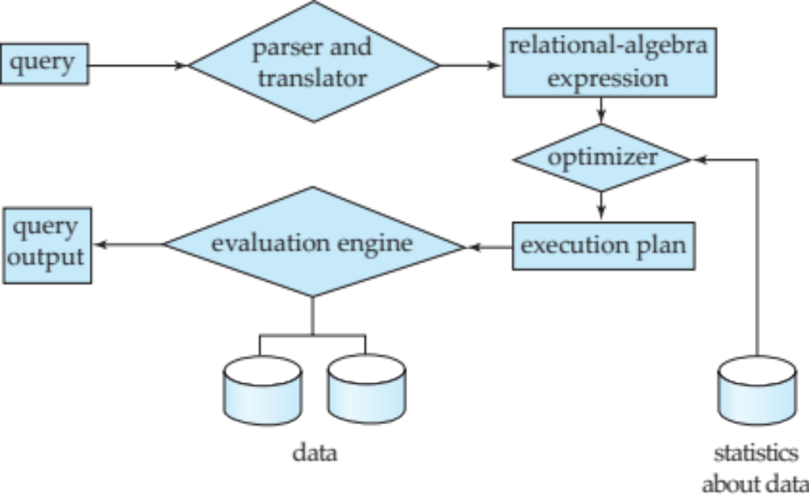
What is Query Processing
1. Query processing steps and algorithms
Query processing is the DBMS workflow that translates a declarative query (SQL) into an efficient sequence of physical operations that produces the actual results.
Output is usually a physical plan (a tree of operators).
Steps for Query Processing
Parsing and translation - check SQL syntax; build a parse tree (translate into a Relational algebra)
Optimization - choose join order + algorithms + access paths.
Evaluation - The query-execution engine takes a query-evaluation plan (logical or physical), executes that plan, and returns the answers to the query.
Remember -
Notation: relational algebra operators like σ (selection), π (projection), ⋈ (join).
Key idea: many different plans can produce the same answer, but with very different runtime.
Steps for Query processing

Slide 4
Query Processing : Optimization
A relational algebra expression may have many equivalent expressions
  E.g., σ_{salary<75000}(∏_{salary}(instructor)) is equivalent to ∏_{salary}(σ_{salary<75000}(instructor))
Each relational algebra operation can be evaluated using one of several different algorithms
  Correspondingly, a relational-algebra expression can be evaluated in many ways.
Annotated expression specifying detailed evaluation strategy is called an evaluation-plan. It can be Logical (relational algebra) or physical plan (execution operators).
  E.g., can use an index on salary to find instructors with salary < 75000,
  or can perform complete relation scan and discard instructors with salary ≥ 75000
Query Optimization: Amongst all equivalent evaluation plans choose the one with lowest cost.
  Example - SELECT * FROM Student WHERE roll_no = 101; (Optimize by - Use roll_no for fast scan)

Slide 5
Query Processing Algorithms - Selection (σ)
Find rows that satisfy a condition
Full table scan: read every page and test the predicate.
  Example - SELECT * FROM Student WHERE University = ‘EIU’;
  Used when no index exists
Index scan: use an index to jump to matching tuples.
  Example - SELECT * FROM Student WHERE roll_no = 101;
Bitmap index scan: combine multiple conditions efficiently.
  Example –
Choice depends on selectivity (how many rows match).
Selectivity example: sel(A=5) = (#rows where A=5) / (total #rows).

Slide 6
Projection Algorithm
The Projection Algorithm is the method used by the DBMS to:
Extract only required columns
Remove duplicate rows (if required)
Store or display the result efficiently
Example – SQL : SELECT Name FROM Student WHERE Marks > 80;
Relational Algebra Representation: π Name ( σ Marks > 80 (Student) )

Slide 7
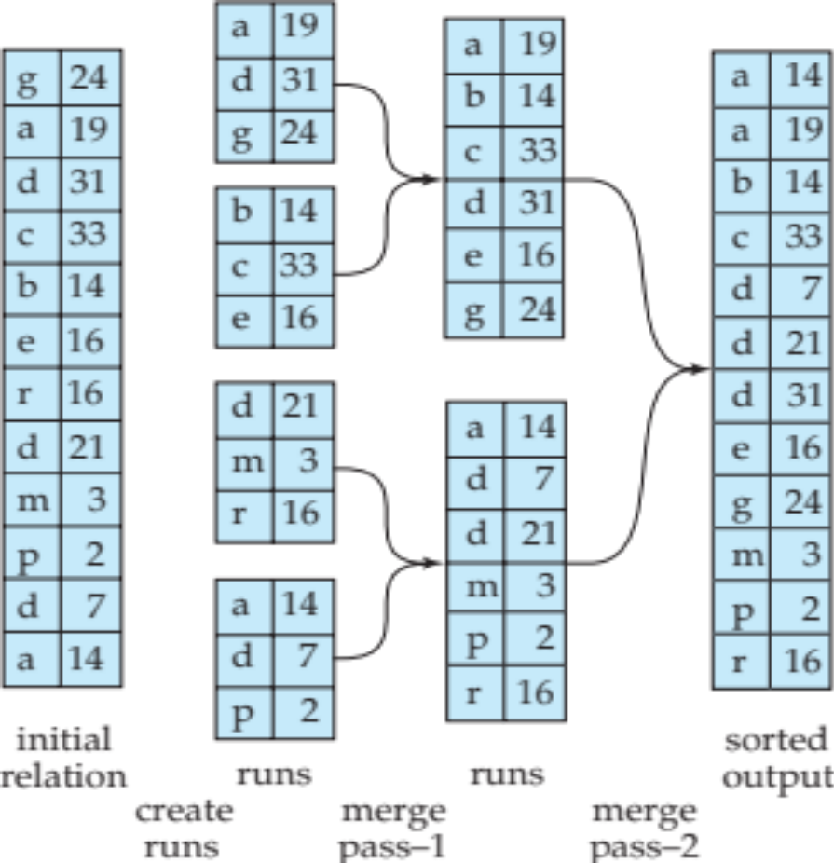
Sorting & Aggregation (GROUP BY)
Two common ways to group
Sort-based: sort by the GROUP BY key, then scan and aggregate.
Hash-based: hash tuples into buckets by key, then aggregate per bucket.
Both may spill to disk if data does not fit in memory.
Common aggregates: COUNT(*), SUM(x), AVG(x).
  Example: AVG(salary) = (SUM(salary)) / (COUNT(*))
For relations that fit in memory, techniques like quicksort can be used.
For relations that don’t fit in memory, external sort-merge is a good choice.
Example- External sort merge

Slide 8
Walkthrough Example
SQL → relational algebra → operator tree
SQL-
SELECT Dept, AVG(Marks) FROM Student WHERE Marks > 80 GROUP BY Dept ORDER BY Dept;
Relational algebra –
SORT Dept (γ Dept, AVG(Marks) (σ Marks > 80 (Student) ))
Final Output-
Execution Flow-
STUDENT TABLE
↓
Selection (Marks > 80)
↓
Projection (Dept, Marks)
↓
External Merge Sort (Dept)
↓
GROUP BY Dept + AVG
↓
Final Result
Dept | AVG (Marks)
CSE | 86.67
ECE | 92.00

Slide 9
Further Reading and Practice
Silberschatz, A., Korth, H. F., & Sudarshan, S. (2020). Database System Concepts (7th ed.). McGraw-Hill. (Part six, Chapter 15. Query processing page no-689 to 740)
Rupley Jr, Michael L. "Introduction to query processing and optimization." Indiana University at South Bend (2008).
Practice with SQL compiler Such as MySQL, PostgreSQL,
  Online compiler - https://sqlfiddle.com/
                https://sqlzoo.net/wiki/SQL_Tutorial

